Slide 1



Department of Computer Science & Engineering
Multimodal Document Intelligence System for Invoice and Receipt Processing Using Vision-Language Models with Layout-Aware OCR
Presented by
Sriganth.G.V
Jayasimbu.J
Aadhiseshan.S
Remo.V
Guided By
Dr.P.Nandhini
HOD/CSE

Slide 2

ABSTRACT
The proposed system is a multimodal document intelligence platform designed to automate invoice and receipt processing using advanced AI models. It combines layout-aware OCR with vision-language models to extract structured information such as vendor details, total amount, tax, and line items from scanned documents, handwritten receipts, and photographed bills. The system supports multiple Indian languages and improves accuracy by understanding both the visual layout and textual content of documents, enabling efficient and intelligent data extraction for enterprise use.

Slide 3

INTRODUCTION
In today’s digital era, businesses handle a large number of invoices and receipts in various formats such as scanned copies, images, and handwritten documents. Traditional data entry methods are time-consuming, error-prone, and inefficient. Although OCR systems exist, they mainly extract raw text without understanding the document structure or context. This project aims to develop a multimodal document intelligence system that combines layout-aware models and vision-language understanding to automatically extract meaningful information from documents, improving accuracy, efficiency, and automation in financial data processing.
Resumes and skill assessments are used to evaluate candidates for job roles.
Currently, the initial screening and assignment of candidate scores is mostly manual.
Manual submission and traditional resume screening take significant time.
Digital ATS systems help manage large volumes of applications efficiently.
This system simplifies the application process through automated skill matching and transparent ranking.

Slide 4

PROBLEM STATEMENT
Current invoice processing systems rely heavily on manual data entry or basic OCR techniques that only extract text without understanding the document layout or context. These systems struggle with complex formats, handwritten content, and multilingual documents. As a result, errors increase and processing time becomes high. Additionally, there is no proper system to extract structured information like line items and tax details accurately, leading to inefficiency in enterprise workflows.

Slide 5

TOOLS USED
Frontend: React.js, JavaScript
Backend: FastAPI (Python-based API framework)
Database: NoSQL(MongoDB) for structured storage
OCR Tools: PaddleOCR
AI Models: LayoutLMv3, Vision-Language Models (Hugging Face)
Libraries: Transformers, OpenCV

Slide 6


SYSTEM ARCHITECTURE
Frontend + API Integration Module: Provides user interface for uploading images through camera or file input, displays extracted results in dashboard, and communicates with backend using FastAPI for processing and data exchange.
OCR Module: Uses PaddleOCR to process input images and extract textual content along with bounding box coordinates, which helps in identifying the position of each text element in the document.
LayoutLMv3 Module: Takes OCR output as input and analyzes the document layout by understanding the spatial structure, relationships, and positioning of text elements to identify meaningful sections.
Vision-Language Model (VLM) Module: Uses both image and extracted text to understand context and semantics, and accurately extracts structured information such as vendor name, total amount, tax details, and line items.

Slide 7

EXISTING SYSTEM
Existing systems mainly use basic OCR techniques that extract only raw text without understanding document structure. These systems fail to handle complex invoice layouts, handwritten text, and multilingual content effectively. Most solutions require manual verification and correction, making the process slow and inefficient.
Problems in Existing System:
Cannot understand document layout properly
Poor accuracy in handwritten and multilingual data
Requires manual data correction
Does not extract structured fields effectively

Slide 8
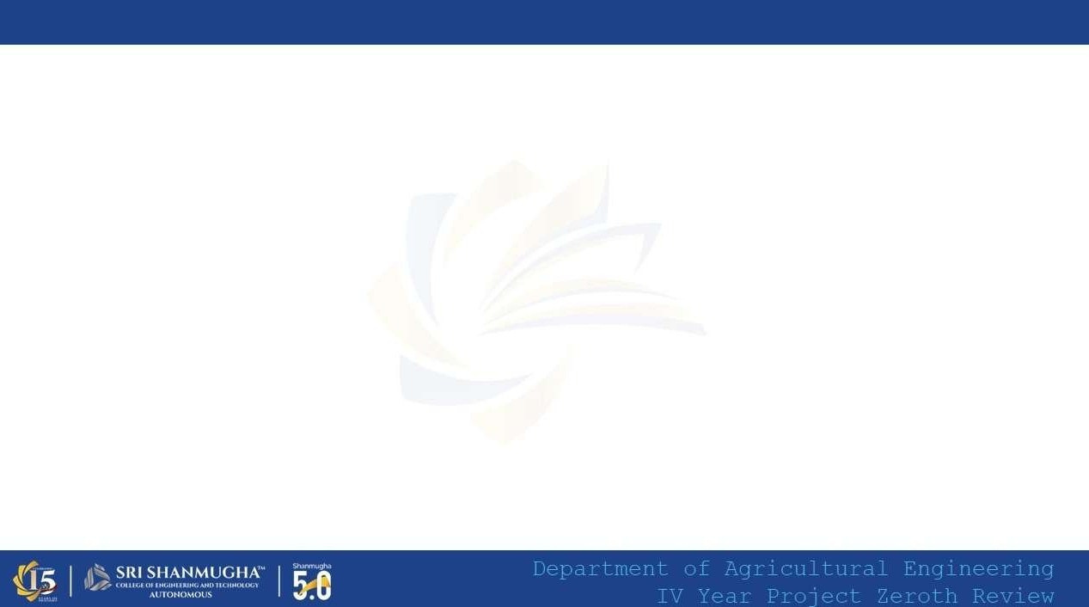

PROPOSE SYSTEM
The proposed system is an intelligent document processing solution that integrates layout-aware OCR with vision-language models to extract structured information from invoices and receipts. It can understand both the visual layout and textual meaning of documents, enabling accurate extraction of key fields such as vendor details, amounts, and line items. The system supports multilingual and handwritten inputs, providing a fully automated and efficient solution for enterprise document processing.

Slide 9
ADVANTAGES
Provides accurate structured data extraction from invoices and receipts
Supports handwritten and multilingual document processing
Reduces manual data entry and human errors
Understands document layout and context effectively
Improves processing speed and automation
Suitable for real-time enterprise applications

Slide 10
THANK YOU

